Slide 1
Chapter One
Introduction to Software Design

Slide 2
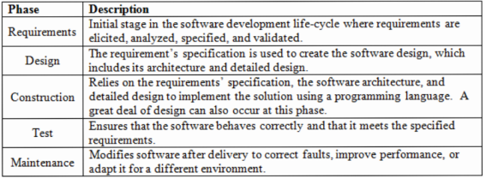
What is Software Design?
Software Engineering: the application of a systematic, disciplined, and quantifiable approach to the development, operation, and maintenance of a SW.
Formal process of Engineering a SW:

Slide 3
What is Software Design?
Envisioning and defining software solutions to one or more sets of problems.
Creation of a specification of a software artifact intended to accomplish goals
Power of imagination (Designer mind set) plus experience...
Blueprint of the SW : How To?
disciplined manner...a systematic approach to ensure that products are built to meet their specification.
The heartbeat of SD: transforming the customer requirements: SRS documents... implementable using a programming language.

Slide 4
What is Software Design?
Cumulative Def:- systematic and intelligent process identifying, evaluating, validating, and specifying the architectural, detailed, and construction models required to build software that meets its intended functional and non-functional requirements
Design in SE: describe both process and product from the process
Process - phase, activities, tasks ... interrelationship between them
Product - artifacts resulting from design activities, e.g., class diagram

Slide 5
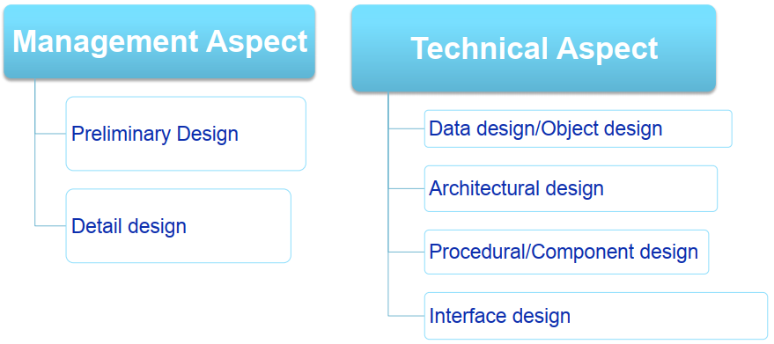
Technical vs. Management aspects of Design

Slide 6
Technical vs. Management aspects of Design
Management Aspect:
- Preliminary Design: customer requirements ... system architecture.
- Detail Design: Refines architectural representation ... Detailed data structure and algorithms.
Technical Aspect:
- Data/ Object Design: transform the information domain into data structures. E.g. Entity Relationship diagrams, Data dictionary, abstract data types, and Data structures
- Architectural Design: overall structure, components (subsystems, modules)... Relationships
- Procedural Design: Structural element to procedural explanations. E.g. Flow chart: represents the architecture of a program as a set of interacting processes that pass data from one to another.

Slide 7
Objectives of SW Design
1. Correctness: Correct as per the requirement
2. Completeness: Incorporate all components like data structures, modules, and external interfaces
3. Efficiency: Resources should be used efficiently by the program
4. Flexibility: Able to modify on changing needs
5. Consistency: There should not be any inconsistency in the design.
6. Maintainability: Simple so that it can be easily maintainable by other designers.

Slide 8
Objectives of SW Design
7. Configurability: as per the data provided in the configuration file.
8. Scalability: support higher loads
9. Usability: ease of use, SW
10. Reliability: consistent functional results
11. Extendibility: support adding more functionalities

Slide 9
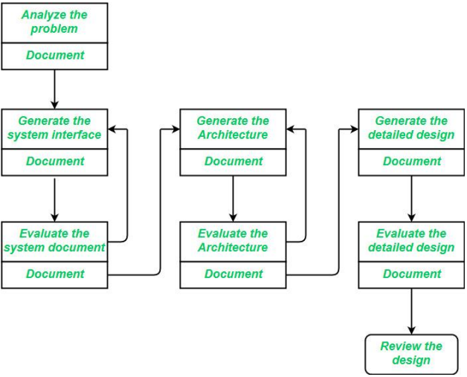
Software Design Process
Three major activities of SW design process
- Interface design
- Architecture Design and
- Detailed Design

Slide 10
Software Design Process
Interface Design: interaction between a system and its environment
- internal systems completely ignored ... System treated as a black box
- focused on the dialogue between the target system and the users, devices, and other systems with which it interacts.
includes: Precise description of events in the environment, or messages from agents to which the system must respond.
- Precise description of the events or messages that the system must produce
- data, and the formats of the data coming into and going out of the system
- ordering and timing relationships between incoming events or messages, and outgoing events or outputs

Slide 11
Software Design Process
Architectural Design: specification of the major components of a system
- responsibilities, properties, interfaces, and the relationships and interactions between them.
- the overall structure of the system is chosen, but the internal details of major components are ignored.
- Lays the foundation for all subsequent work in the software engineering lifecycle.
- It provides the major structural components and interfaces of the system.

Slide 12
Software Design Process
- It focuses on the quality aspects of the system before detailed design or construction can begin
Issues in architectural design:
- Gross decomposition of the systems into major components.
- Allocation of functional responsibilities to components.
- Component Interfaces
- Component scaling and performance properties, resource consumption properties, reliability properties, and so forth.
- Communication and interaction between components.

Slide 13
Software Design Process
Detailed Design: specification of the internal elements of all major system components.
- their properties, relationships, processing, and often their algorithms and the data structures
- Begins after the software architecture activity is specified, reviewed, and deemed sufficiently complete
- Focuses on functional requirements, whereas the architecture focuses mostly on non-functional, or quality, requirements.

Slide 14
Software Design Process
The detailed design may include:
- Decomposition of major system components into program units.
- Allocation of functional responsibilities to units.
- User interfaces
- Unit states and state changes
- Data and control interaction between units
- Data packaging and implementation, including issues of scope and visibility of program elements
- Algorithms and data structures

Slide 15
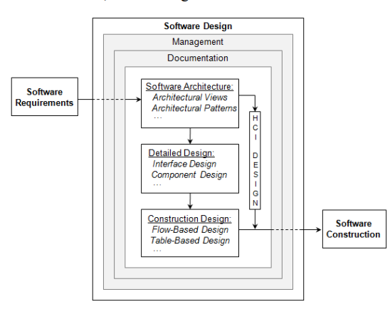
Software Design Process
Design documentation
and Management

Slide 16
Design Considerations
Compatibility - operate with other products ... E.g. older versions
Extensibility - New capabilities can be added to the software without major changes to the underlying architecture
Modularity - comprises well-defined, independent components... implemented and tested in isolation before being integrated to form a desired software system.
Fault-tolerance - The software is resistant to and able to recover from component failure.
Maintainability - ease in bug fixes or functional modifications can be accomplished. High maintainability can be the product of modularity and extensibility.
Reliability (Software durability) - perform a required function under stated conditions for a specified period of time.

Slide 17
Design Considerations
Reusability - The ability to use some or all of the aspects of the preexisting software in other projects with little to no modification.
Robustness - operate under stress or tolerate unpredictable or invalid input.
Security - The software is able to withstand and resist hostile acts and influences
Usability - The software user interface must be usable for its target user/audience
Performance – The software performs its tasks within a time frame that is acceptable for the user, and does not require too much memory.
Portability – The software should be usable across a number of different conditions and environments
Scalability – The software adapts well to increasing data or added features or the number of users

Slide 18
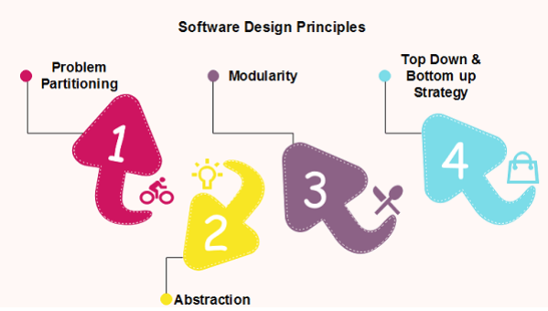
Design Principles
Providing means to handle the complexity of the design process effectively.
not only reduce the effort needed for design but can also reduce the scope of introducing errors during design.

Slide 19
Problem Partitioning
For small problems, we can handle the entire problem at once but for the significant the problem, divide the problems and conquer the problem.
For software design, the goal is to divide the problem into manageable pieces
Benefits of Problem Partitioning 1. Software is easy to understand 2. Software becomes simple 3. Software is easy to test 4. Software is easy to modify 5. Software is easy to maintain 6. Software is easy to expand

Slide 20
Abstraction
Consider a component at an abstract level without bothering about the internal details of the implementation.
Abstraction can be used for existing elements as well as the component being designed
there are two common abstraction mechanisms 1. Functional Abstraction
A module is specified by the method it performs
The details of the algorithm to accomplish the functions are not visible to the user of the function.
Function-oriented design approach 2. Data Abstraction
Details of the data elements are not visible to the users of the data.
Object-oriented design approach

Slide 21
Modularity
the division of software into separate modules which are differently named and addressed and are integrated later on in to obtain the completely functional software.
the only property that allows a program to be intellectually manageable
The desirable properties of a modular system are: - Each module is a well-defined system that can be used with other applications. - Each module has single specified objectives. - Modules can be separately compiled and saved in the library. - Modules should be easier to use than to build.

Slide 22
Aspects of Modular Design
1. Functional independence:
- developing functions that perform only one kind of task and do not excessively interact with other modules.
- it makes implementation more accessible and faster
- The independent modules are easier to maintain, test, and reduce error propagation and can be reused in other programs as well
It is measured using two criteria:
Cohesion: It measures the relative function strength of a module.
Coupling: It measures the relative interdependence among modules.

Slide 23
Continued...
2. Information hiding - modules should be specified that data included within a module is inaccessible to other modules that do not need such information.
- most significant when modifications are required during testing and later during software maintenance
- inadvertent errors introduced during modifications are less likely to propagate to different locations within the software.

Slide 24
Advantages of Modular Design
It allows large programs to be written by several or different people
It encourages the creation of commonly used routines to be placed in the library and used by other programs.
It simplifies the overlay procedure of loading a large program into main storage.
It provides more checkpoints to measure progress.
It provides a framework for complete testing, more accessible to test
It produced the well designed and more readable program

Slide 25
Disadvantages of Modular Design
Execution time maybe, but not certainly, longer
Storage size perhaps, but is not certain, increased
Compilation and loading time may be longer
Inter-module communication problems may be increased
More linkage required, run-time may be longer, more source lines must be written, and more documentation has to be done

Slide 26
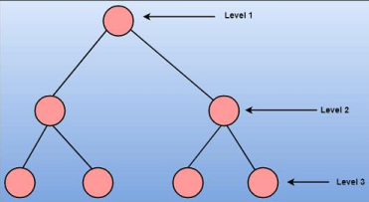
Strategy of Design
Structured design methods help developers to deal with the size and complexity of programs
To design a system, there are two possible approaches: 1. Top-down Approach 2. Bottom-up Approach
Top-down Approach: This approach starts with the identification of the main components and then decomposing them into their more detailed sub-components.

Slide 27
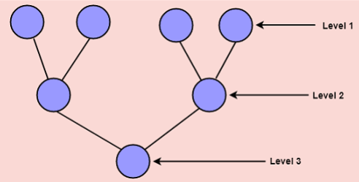
Continued...
Bottom-up Approach: A bottom-up approach begins with the lower details and moves toward the hierarchy, as shown in fig. This approach is suitable in the case of an existing system.

Slide 28
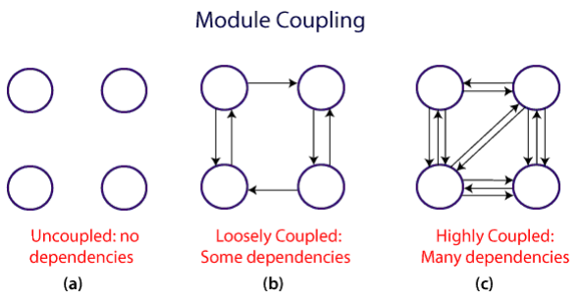
Coupling and Cohesion
Module Coupling: Inter-dependability
- The degree of interdependence between software modules
- Two modules that are tightly coupled are strongly dependent on each other
- However, two modules that are loosely coupled are not dependent on each other. Uncoupled modules have no interdependence at all within them

Slide 29
Continued...
A good design is one that has low coupling.
Coupling is measured by the number of relations between the modules.
Coupling increases as the number of calls between modules increases or the amount of shared data is large.
A design with high coupling will have more errors.

Slide 30
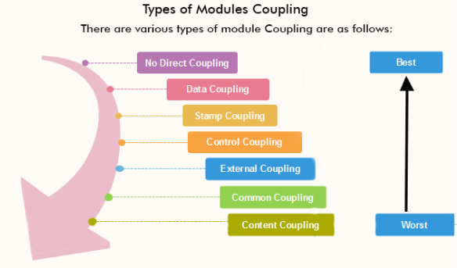
Types of Module Coupling

Slide 31
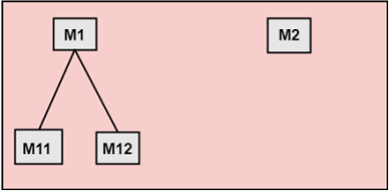
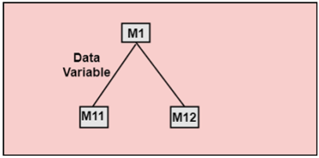
Types of Module Coupling
1. No Direct Coupling: There is no direct coupling between M1 and M2.
2. Data Coupling: When data of one module is passed to another module, this is called data coupling

Slide 32
Continued...
3. Stamp Coupling: Two modules are stamp coupled if they communicate using composite data items such as structure, objects, etc.
Use the same data structure but work on a different part of it
- When the module passes the nonglobal data structure or entire structure to another module, they are said to be stamp coupled. For example, passing structure variable in C or object in C++ language to a module. 4. Control Coupling: exists among two modules if data from one module is used to direct the structure of instruction execution in another. 5. External Coupling: two modules share an externally imposed data format, communication protocols, or device interface. This is related to communication to external tools and devices.

Slide 33
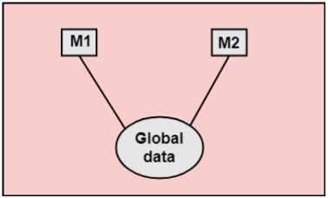
Continued...
6. Common Coupling: if they share information through some global data items
7. Content Coupling: Content Coupling exists among two modules if they share code, can access or modify the content of another module. e.g., a branch from one module into another module

Slide 34
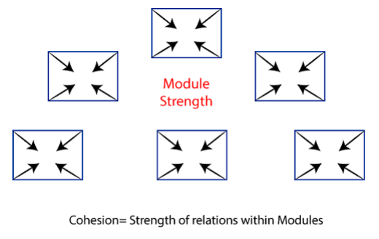
Module Cohesion /Intra-dependability
degree to which the elements of a module belong together
strength of relationships between pieces of functionality within a given module
For example, in highly cohesive systems, functionality is strongly related.

Slide 35
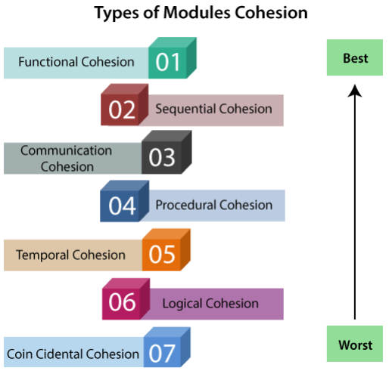
Continued...

Slide 36
Continued...
Functional Cohesion: if the different elements of a module, cooperate to achieve a single function
Sequential Cohesion: if the element of a module form the components of the sequence, where the output from one component of the sequence is input to the next. /Data Flowing /
Communicational Cohesion: A module is said to have communicational cohesion, if all tasks of the module refer to or update the same data structure, e.g. Array or Stack
Procedural Cohesion: if the set of purposes of the module are all parts of a procedure in which a particular sequence of steps has to be carried out for achieving a goal, e.g., the algorithm for decoding a message. /Functionality Flowing /

Slide 37
Continued ...
5. Temporal Cohesion: When a module includes functions that are associated with the fact that all the methods must be executed at the same time.
6. Logical Cohesion: if all the elements of the module perform a similar operation (logically related). For example Error handling, data input and data output, etc.
7. Coincidental Cohesion: A module is said to have coincidental cohesion if it performs a set of tasks that are associated with each other very loosely, it is unplanned and random: Creating confusion.

Slide 38
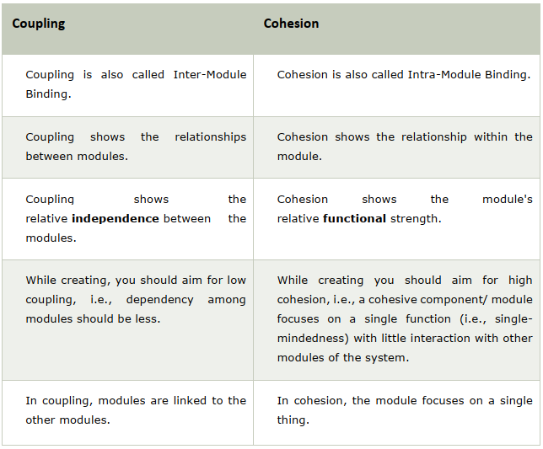
Differences between Coupling and Cohesion

Slide 39
Davis's Design Principles
The design process should not suffer from “tunnel vision.” be all rounded/ see out of the box
The design should be traceable to the analysis model/SRS
The design should not reinvent the wheel.
The design should "minimize the intellectual distance" between the software and the problem as it exists in the real world.
The design should exhibit uniformity and integration.
The design should be structured to accommodate change.

Slide 40
Continued...
The design should be structured to degrade gently, even when aberrant data, events, or operating conditions are encountered /”Not Bomb”
Design is not coding, coding is not design.
The design should be assessed for quality as it is being created, not after the fact.
The design should be reviewed to minimize conceptual (semantic) errors. omissions, ambiguity, inconsistency...

Slide 41
Design Patterns
Best practices ... Experienced OOSD
Solutions for Generic/repeating problems ... Found by trial and error
Templates: How to? Experiences...
Smart, Generic, Well Proven, Simple, Reusable, and OO
GoF (1994, Erich Gamma, Richard Helm, Ralph Johnson, and John Vlissides)
Used as a common platform/ template for developers and best practices

Slide 42
Design Patterns
Types of Design Patterns :
1. Creational: create an object - hide logic -> Flexible
2. Structural: compose class and object, obj of one class used in another class
3. Behavioral: communication between objects.

Slide 43
Benefits and Drawbacks
Benefits:
- increase productivity
- reuse of development efforts
- proven solutions for common problems
- consistency between applications
Drawbacks:
- Developers learn large number of patterns
- Actual problems are very diverse /unique

Slide 44
